Slide 1
Introduction on Java

Slide 2
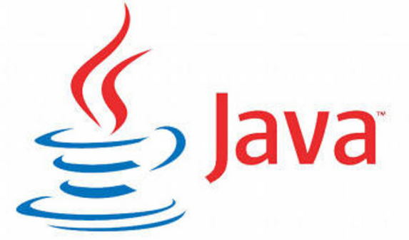
Learning Objectives for Introduction
Introduction
Java Buzzwords or Features
Installing JDK Software
Class & Object
Keywords
Structure of Java Program
Data Types
Arrays
Main method
Command line arguments
JVM & Memory Model

Slide 3
What is Java
JAVA was developed by Sun Microsystems Inc in 1991, later acquired by Oracle Corporation. It is a simple programming language. Writing, compiling and debugging a program is easy in java. It helps to create modular programs and reusable code
Features of Java
1. Platform independent language
2. Object Oriented language
a) Abstraction
b) Encapsulation
c) Inheritance
d) Polymorphism
3. Simple
4. Robust Language
5. Secure

Slide 4
Features Contd.
6. Java is Distributed
7. Multithreading
8. Portable

Slide 5
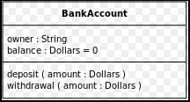
Class
A class is a group of objects which have common properties. It is a template or blueprint from which objects are created.
A class in Java can contain
Fields
Methods
Constructors
Nested class
Syntax to declare a class
class <class_name> {
field;
method;
}

Slide 6
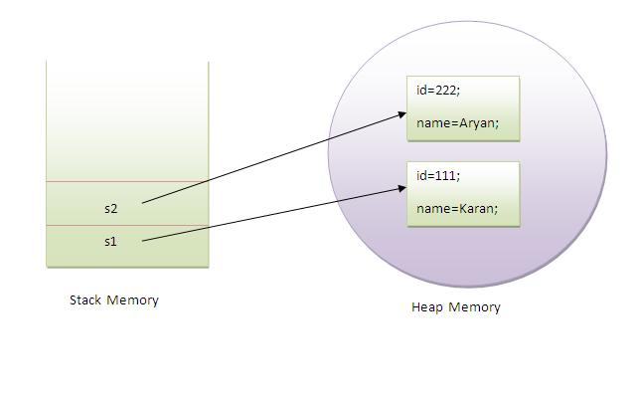
Objects
Objects have states, id and behaviors.
Example: A dog has states - color, name, breed as well as behaviors – wagging the tail, barking, eating. An object is an instance of a class

Slide 7
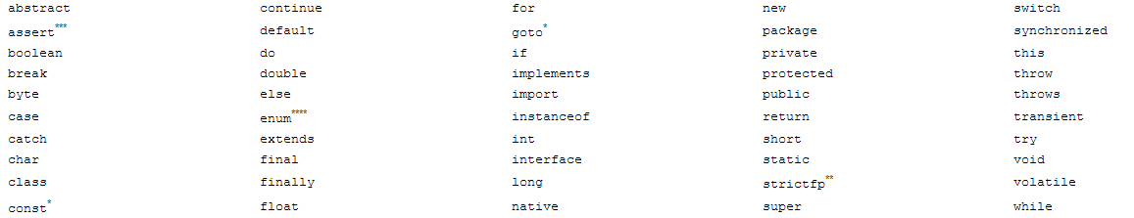
Keywords
Keyword is one of 53 reserved words that have a predefined meaning in the language; because of this, programmers cannot use keywords as names for variables, methods, classes, or as any other identifier

Slide 8
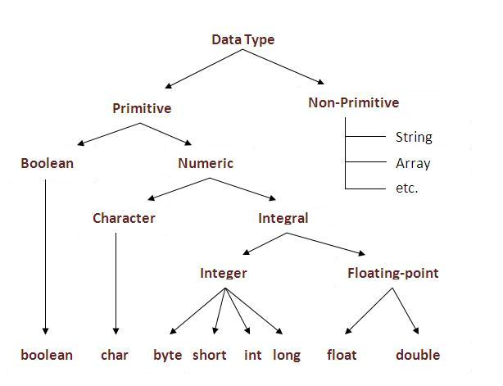
Data Types

Slide 9
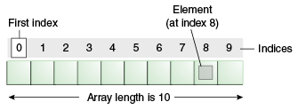
Java array is an object the contains elements of similar data type. It is a data structure where we store similar elements. We can store only fixed set of elements in a java array.
Array in java is index based, first element of the array is stored at 0 index.
Arrays
Java array is an object the contains elements of similar data type. It is a data structure where we store similar elements. We can store only fixed set of elements in a java array.
Types
Single Dimension
Multi Dimension
Array in java is index based, first element of the array is stored at 0 index.

Slide 10
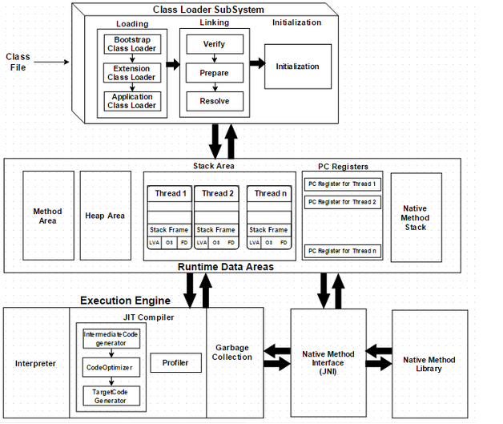
Java array is an object the contains elements of similar data type. It is a data structure where we store similar elements. We can store only fixed set of elements in a java array.
Array in java is index based, first element of the array is stored at 0 index.
Java Memory Model

Slide 11
What are we learning in Next Chapter ?
Arithmetic Operators
Increment or Decrement Operator
Relational Operators
Equality Operators
Logical operators
Short-circuit(or conditional) operators
Ternary operator
Assignment Operators
Type Casting
Selection Statements
Iteration Statements
Transfer Statements

Slide 12
Thank You !

